Slide 1
Leveraging Enterprise Library in Your Applications
Keith Elder
Quicken Loans
Manager, Sr. Software Engineer
Microsoft MVP
Keith a t keithelder dot net
Blog: http://keithelder.net/blog/

Slide 2









About Quicken Loans
Originally founded in 1985 as Rock Financial by Dan Gilbert
  Grew to one of the largest independent mortgage banks in the country
  1998 IPO
  1999 Launched Rockloans.Com
1999 Intuit, Inc (makers of TurboTax and Quicken) purchased Rock Financial.
July 2002 Dan Gilbert purchased Quicken Loans back from Intuit. Retained Quicken Loans branding and marketing initiatives.
4500 employees
Largest online retail home loan lender

Slide 3
Take Aways
Why would I want to use EntLib?
How do I incorporate it into my solutions with source control?
Code samples
How do I use it?

Slide 4
What is Enterprise Library
Set of tools and programming libraries for .Net framework
Developed by Patterns and Practices Team
Benefits
  Improved Productivity: Each of the Application Blocks provides several interfaces meant to satisfy common application concerns.
  Configuration Driven Design: Many technical decisions about the application behavior can be delayed until configuration time of the application.
Broken down into re-usable blocks

Slide 5
Getting Started

Slide 6
Setup Tips
Download MSI from Microsoft web site
https://www.microsoft.com/downloads/details.aspx?familyid=4C557C63-708F-4280-8F0C-637481C31718&displaylang=en
Installing source code is optional
Once setup prepare a version to be used in projects
  Full
  Runtime
Familiarize yourself with EntLib Console

Slide 7
C:\Dev\MyApp
Folder Structure For Application
Source
Module
HelpDesk
Project Folder
WebService
BusinessLayer
Project
Folders
Company.MyApp.HelpDesk.BusinessLayer
DataLayer
WorkFlow
Company.MyApp.HelpDesk.DataLayer
UI
WinForm
Web
Company.MyApp.HelpDesk.UI.WinForm
Mobile
Company.MyApp.HelpDesk.UI.Mobile
Common
ThirdPartyAssemblies

Slide 8
Suggested Way To Add EntLib to Your Projects
C:\Dev\MyApp
Full – Take all the files from c:\Program Files\Microsoft Enterprise …..\bin\* except the .xml files
  Any custom exceptions thrown will need to have DLLs copied here so config tool works properly
Runtime – All the DLLs that you add as a reference. Exclude *.design.* DLLs
Source
ThirdPartyAssemblies
EnterpriseLibrary
Full
Runtime
(see talk on Structure and Guidance for Organizing Solutions in Visual Studio)

Slide 9
Enterprise Library Console

Slide 10
Application Blocks
Caching
Data Access
Cryptography
Exception Handling
Logging
Policy Injection
Security
Validation

Slide 11
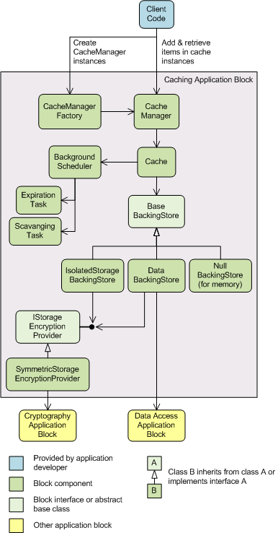
Caching Block
Isolated Storage
Database
Custom
Allows for encryption of cached data through Cryptography block

Slide 12
Caching Block Demo

Slide 13
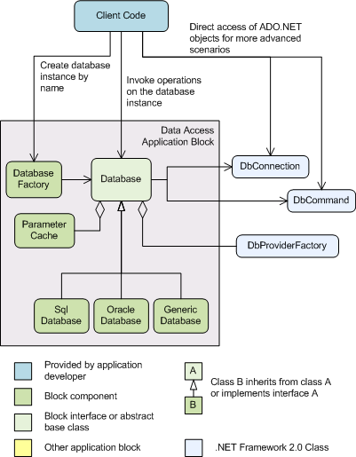
Data Access
Uses Ado.Net 2.0
Reduces the need to write boilerplate code for standard tasks
Maintain consistent data access practices
Relieves developers from learning different programming models for different types of database
Reduces the amount of code that developers must write when they port applications to different databases
Other Blocks That Use It
  Caching (schema provided)
  Logging (schema provided)
    Exception Handling

Slide 14
Data Access Block Demo

Slide 15
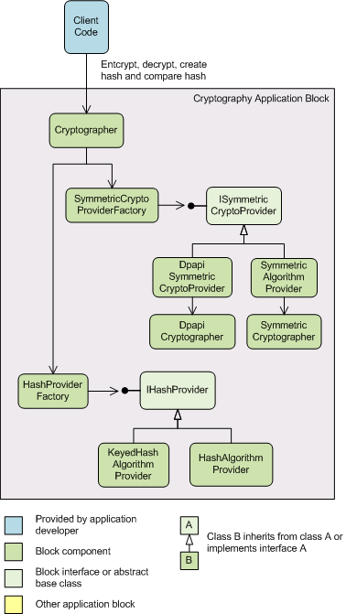
Cryptography
Reduces the need to write boilerplate code for standard tasks
Maintain consistent cryptography practices within applications and across the enterprise
Easy learning curve for developers
Provides implementations to solve common application cryptography problems
Extensible, implement your own

Slide 16
Cryptography Demo

Slide 17
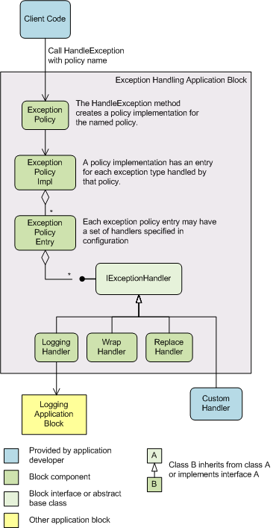
Exception
Supports exception handling in all architectural layers of an application
Allows exception policies to be defined and maintained by admins or devs, can change on the fly
Common tasks
  Logging
  Hide sensitive information by replacing original exception with another
  Eat exceptions
Developers can create their own exception handlers

Slide 18
Logging
Write information to a variety of places
  Event log
  Email message
  Database (schema provided)
  Message Queue
  Text File (supports rolling files)
  WMI Event
  Custom location using extension points
Application code does not specify the destination for the information, configuration settings determine whether the block writes the information and where
http://msdn2.microsoft.com/en-us/library/aa480464.aspx

Slide 19
Exception Handling & Logging
Demo

Slide 20
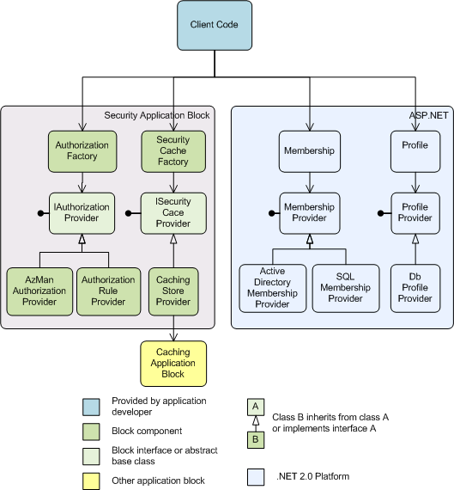
Security
Reduces boilerplate code for standard tasks
Maintains consisent security practices within applications and enterprise
Eases learning curve
Change security roles and permissions on the fly
Extensible

Slide 21
Security
Demo

Slide 22
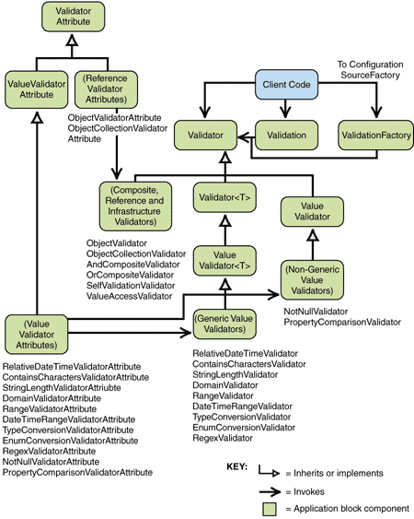
Validation Block
Three ways to perform validation
  Using configuration
  Using attributes
  Using code
Includes adapters for
  Asp.Net
  Windows Forms
  Windows Communication Foundation
Includes validators for most standard .Net data types
Associate multiple rule sets with the same class and with members of that class

Slide 23
Validation
Demo

Slide 24
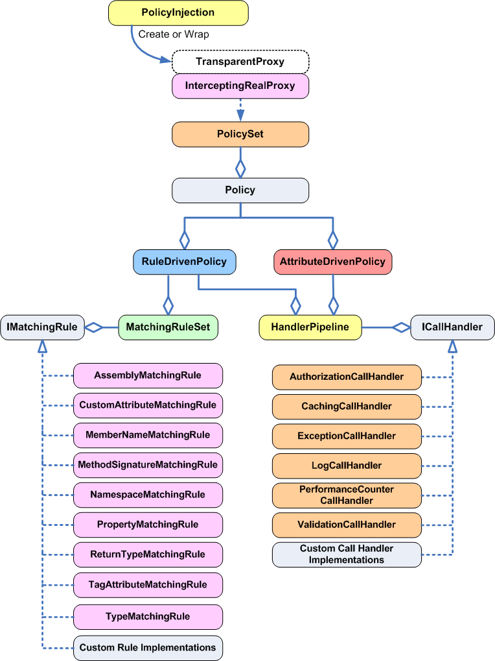
Policy Injection Block
Apply policies to object instances
Rules
  Assembly
  CustomAttribute
  MemberName
  MethodSignature
  Namspace
  Property
  ReturnType
  TagAttribute
  Type
Example:
  account.Withdraw(25)
    Security, Logging, Validation

Slide 25
Policy Injection
Demo

Slide 26
Combing the blocks
Demo

Slide 27
Resources
Patterns and Practices
  http://msdn.microsoft.com/practices/
    Smart Client Software Factory
    Enterprise Library
    Web Services Software Factory
    Mobile Software Factory
My Blog
  http://keithelder.net/blog/
Email
  Keith a t keithelder dot net

